Slide 1
Topic 06 – Data Sharing, Data Consolidation and Scheduling
BDM3302: Data Management

Slide 2
Why we need data sharing?
An organization acquires important insight by analyzing data they share with other departments.
finance teams need sales data to forecast future financial performance.
Product management teams require marketing data to determine future products and services.
Executive management needs up-to-the minute dashboards, fueled by data from many parts of the enterprise, to make timely, data-driven business decisions.

Slide 3
Why we need data sharing?
Outside an organization, retailers share sales data with their vendors to manage inventory and supply chains.
Software-as-a- service (SaaS) providers share the data they collect with their customers to provide them with deeper insights into their business.
Healthcare providers securely share patient data with vendors that provide ancillary products and with other business partners that analyze that data to help improve patient services.
Data has become more than something to collect and analyze. It’s an asset you can easily and securely make available inside and outside your organization to streamline operations, swiftly deliver more-personalized customer experiences, and open up new market opportunities.

Slide 4
What is Data Sharing?
Data can originate from the many software applications an enterprise uses to run its business, from the constant activity of visitors engaging a website, from a mobile phone, or from an Internet of Things (IoT) device attached to the refrigerator and other electronic appliances in your home.
An organization can use data to track business results, make decisions, engage customers, define and create products, forecast trends, and more.
Data is also a resource used and consumed between organizations, internal and external to one another, to collaborate on business plans, mutual initiatives, or joint opportunities.

Slide 5
What is Data Sharing?
Many enterprises have come to realize they could enhance their business operations if they had access to data outside their organizations. Enterprises also recognize it is not easy to access data they don’t generate themselves.
Data sharing is the act of providing access to data between business units inside the organization, or between organizations external to each other.
The organization that shares its data is called a “data provider”. The organization that wants to utilize shared data is called the “data consumer”. Any organization can be a data provider, data consumer, or both.

Slide 6
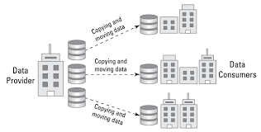
Traditional Data Sharing

Slide 7
Traditional Data Sharing
Some organizations have traditionally shared data by making a copy of the shared data and sending it to their data consumers.
The data consumers then download the data to analyze or combine that data with their existing data for deeper insights into who their customers are, how efficiently their business operates, and into which new industries their business is heading.
This process is slow, cumbersome, and costly and only allows for moving limited amounts of shared data.

Slide 8
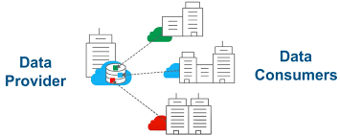
Modern Data Sharing

Slide 9
Modern Data Sharing
A modern data sharing happens without moving data.
A data provider makes available live, fast, secure, and read-only copies of data to its data consumers via modern cloud data sharing.
New business opportunities modern cloud data sharing makes possible:
Data sharing to eliminate data silos – develop a single database and share among business units within an organization
Data sharing for business efficiencies - share live data with your business partners
Data sharing as a product – provide live and direct access to data as a monetized service.
Data sharing as a product differentiator – SaaS providers can offer direct access to data generated from B2B subscriber’s activity and perform deeper analysis.

Slide 10
How Organizations Share Data
Email
File Transfer Protocol (FTP)
Extract, Transfer, Load (ETL)
Online File Sharing Services
Cloud Storage
Application Programming Interfaces (APIs)

Slide 11
Advantages of Data Sharing
Data sharing improves company outcomes: Firms that support data sharing will outperform their counterparts on the majority of business value criteria.
Innovative Technologies: implement AI/ML for accurate predictive data analysis.
Unified View: Create a unified source of the truth across all departments.
Transparency: Develop openness and transparency among stakeholders for improved decision-making.
Speed: Widen the area of analysis for an organization's data consumers.

Slide 12
Advantages of Data Sharing
Flexibility: Create new analytic reports swiftly and with fewer interruptions.
Synergy: Data sharing has intrinsic advantages for the researcher and research sponsor. Making the data accessible to their colleagues and the general public encourages academics to better manage and assure the quality of their data.
Improving Science and Decision-making: Sharing data enhances data circulation and usage within the scientific community by fostering more openness, facilitating the reproducibility of discoveries, and enlightening the scientific community at large.
Collaboration: Sharing data stimulates more interaction and cooperation among academics, which may lead to significant new discoveries in the area.

Slide 13
Disadvantages of Data Sharing
The more data openness the higher digital security risks: data sharing needs information systems to be open so that data may be viewed and shared. This may expose further portions of an organization to digital security risks that may result in events that compromise the availability, integrity, or confidentiality of data and information systems upon which economic and social activities depend.
Higher impact of personal data breaches: Where data is accessible and shared, personal data breaches are potential. They will not only create damage from personal data loss. They may also result in substantial economic losses for the afflicted firm, such as a loss of competitiveness and reputation.
Violation of privacy, intellectual property rights, and other interests: The hazards of increased access and sharing extend beyond breaches of digital security and personal data. They include risks of breaking contractual and socially agreed-upon conditions of data re-use, and therefore risks of acting against the reasonable expectations of users.

Slide 14
Disadvantages of Data Sharing
Data reuse in violation of agreed terms and expectations: Even when people and organizations agree to and consent to particular conditions for data sharing and data re-use, including the reasons for which the data should be re-used, there is a high danger that a third party would deliberately or accidentally use the data differently.
Loss of authority over data and the significance of permission: Unless certain data stewardship and processing rules are in place, once data are accessed or shared, they will leave the information system of the original data holder and therefore be out of his/her control. The same is true for those who supply their data and agree to its reuse and distribution. Then, data owners and people lose control over how their data are repurposed.
The limitations of anonymization and the growing potential of data analytics: Once connected to sufficient additional information, it is possible to forecast an individual's chance of possessing certain qualities in order to construct a profile. Even if the inferences are valid, there is a possibility that they might be exploited against an individual's best interests, desires, or expectations.

Slide 15
Data Sharing for Business-to-Business (B2B)
Whether sharing data to external organizations or receiving shared data from them, if organizations cannot collaborate on data, they are less efficient and run the risk of operating at a higher cost and lower productivity.
Examples of B2B Data Sharing:
» A hotel booking website shares reservation patterns and trends with hotel properties to develop promotional and pricing programs.
» A grocery chain provides store sales data to suppliers to ensure shelves are adequately stocked to meet demand.
» Retailers share in-store sales data for merchandising, so the hot items are always available.

Slide 16
Business Value of Data Sharing for Organizations
Data sharing across and beyond an organization consists of four basic workflows:
Across lines of business (LOBs): Sharing data between business units within the same organization
Between organizations: Outbound data sharing to another, separate organization to benefit your business
Between organizations: Receiving inbound data shared from another organization to benefit your business
Monetizing data: Sharing live data as a service so data consumers can enrich their own, existing data

Slide 17
Sharing Data Across Line of Business (LOB)
Within the same organization, business units depend on email, spreadsheets, shared network drives, application programming interfaces (APIs), and other methods for communicating and for sharing data. Sharing data across an organization enables and fosters increased levels of business intelligence and drives timely and informed business decisions.
Within an organization, however, data is often locked in silos. Mergers or acquisitions, firewall restrictions, or other business or technology barriers often restrict an organization from easily sharing data across its business units. These physical or logical separations of infrastructure can prevent two or more business units from accessing all available data within an organization to deliver all-inclusive, data-driven insights. These data silos emerge when an organization relies on a traditional, on-premises data warehouse or a traditional data warehouse ported to the cloud.

Slide 18
Sharing Between Organizations: Outbound
External data sharing takes place all the time. A vendor-supplier relationship, a partner relationship, a developer-producer relationship — or any number of other business relationships — all require two or more organizations to collaborate with data to drive business. The primary organization is sharing data, outbound, to the partner organization.
For example, in a vendor-supplier relationship with data sharing, a supplier knows in advance when to replenish the stock of a particular item. Well-managed inventory also prevents overstocking, minimizing the need to significantly reduce prices.

Slide 19
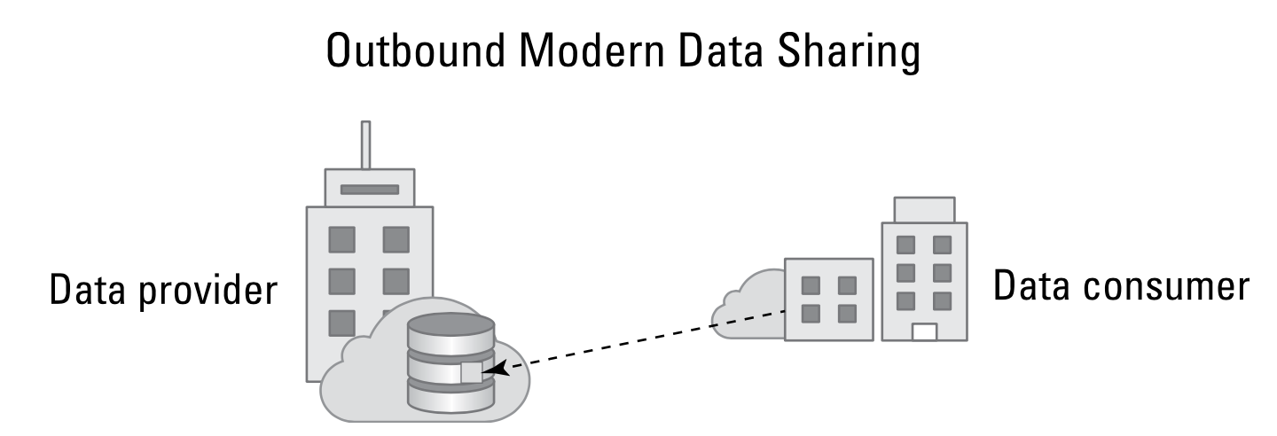
Sharing Between Organizations: Outbound
Organization
Supplier
An organization, acting as the data provider, shares data with its supplier, the data consumer.

Slide 20
Sharing Between Organizations: Inbound
Increasingly, organizations engage outside service companies. These contracted companies can specialize in logistics, shipping, marketing services, or sales operations, just to name a few. For example, a large retailer would collect massive amounts of demographic data about its target customers. The retailer would then share this data as a data provider to a data analytics company. The analytics company would analyze the data for the retailer.

Slide 21
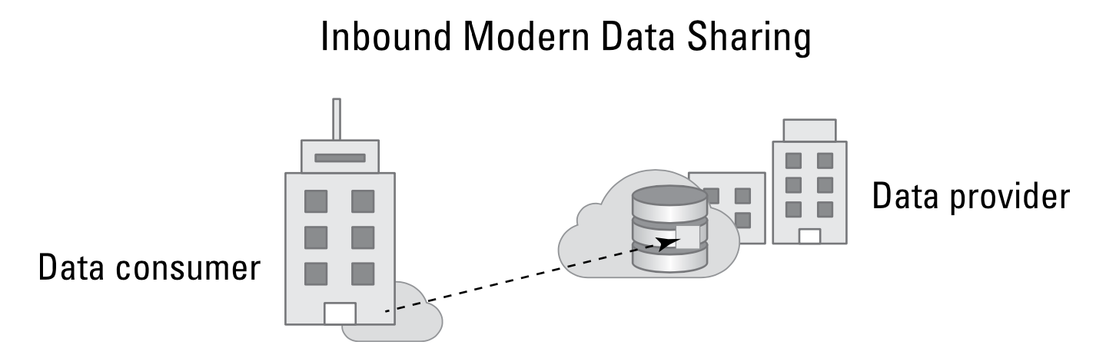
Sharing Between Organizations: Inbound
Data Analytics Vendor
Organization
The organization is the data consumer, accessing the data from its outside data analytics vendor, which is the data provider.

Slide 22
Sharing Between Organizations: Inbound
The organization contracts a service provider to perform a function the organization chooses not to perform in- house. In turn, the service provider generates data as a result of that service — data that belongs to the organization, which is the service provider’s customer. With inbound data sharing between organizations, the data generated by the service provider is shared with its customer. The customer then executes additional analytics to develop deeper insights and value from additional data generated outside its data center but within its business ecosystem.

Slide 23
Monetizing Data
Data can also take on more significance today than just day- to-day collaboration. Data is a business asset — a currency. As such, data can offer different types of value depending on the organization that wants to consume that data. Thus, as with any asset, data has value. To monetize the value of its data, a provider can sell data to consumers that can then use the data to advance their own business objectives.
Data consumers can use shared data without having to capture and collect it themselves. They can benefit directly from analyzing that data or combining it with other data to enhance its value.

Slide 24
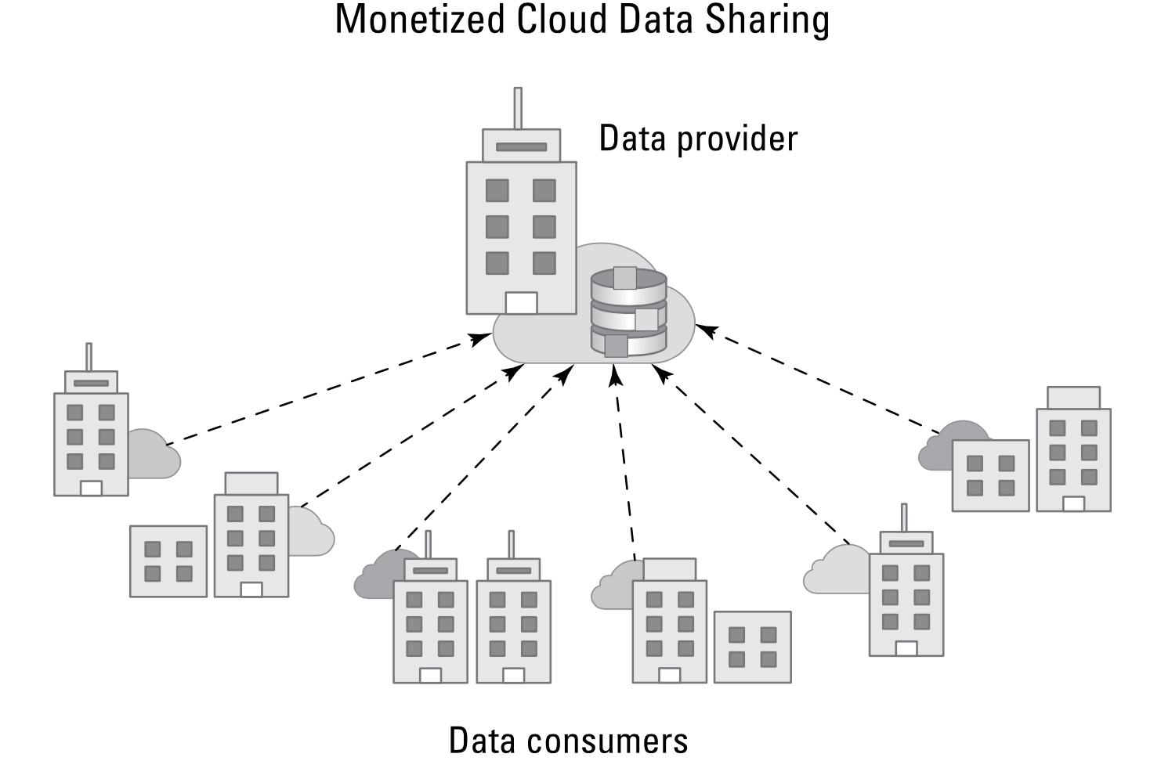
Monetizing Data
An enterprise data provider creates new revenue opportunities by sharing data with other organizations acting as data consumers.

Slide 25
Monetizing Data
Data monetization is a process by which a data provider charges data consumers a fee to gain access to the provider’s data or data services, so a data consumer can enrich its existing data sets to benefit its business and its customers. Some providers offer access to the data itself while others offer services, such as data modeling, data enrichment, and data analytics.
Nielsen is a pioneer and offers service for more than 90 years, the company has collected, analyzed, and sold consumer data to media companies, advertising firms, retail organizations, and many other industries.
Nielsen’s proven business model has inspired numerous niche data sharing opportunities. For example, in the financial services industry, some companies collect stock market data, package it, and sell it to brokers and hedge funds.

Slide 26
Data Consolidation
Many companies are looking for ways to increase their competitiveness, their efficiency and effectiveness and their adaptability to unexpected changes. Data consolidation enables business to retrieve data from all their departments in a comprehensive way and prepares data to make predictions, detect errors and make decisions.
However, many times the data different sources that companies store is made up of data from diverse origins, with various formats and with different purposes. This can result in duplication, different data types and formats, or problems with data security.
In addition, this great diversity makes it difficult to quickly and efficiently analyze the data, so it must be treated to make it more uniform, eliminate errors and duplicates, and for it to be in the right place, such as a data warehouse or data lake.
This process is also known as data integration and can be carried out using various methods that allow different types of data to be manipulated from a single location to become corporate insight data that will lead to better decision making.

Slide 27
Data Consolidation
Data consolidation is the process of combining data from multiple sources, cleaning and verifying it by removing errors, and storing it in a single location, such as a data warehouse or database. Data is produced from various sources and in multiple formats in every business. The data consolidation process makes it easier to unify that data.
Consolidating data enables companies to efficiently plan, implement, and execute business processes and disaster recovery solutions. This is done because all critical data in one place grants users a 360-degree view of all their business assets. It improves data quality, fast-tracks process execution, and simplifies information access.
This process ensures that quality and accurate data is available, making it quicker and easier to process and treat this data. Data consolidation eliminates disparities before data is used, saving time, improving efficiency and adding value to the company's analytical operations.

Slide 28
Centralized Implementation
The centralized Implementation enables you to efficiently create and manage master data attributes in one place. It supports the validation and verification of data at the origin and always guarantees high-quality data, across all business systems. Once the data is curated, it’s automatically available to other systems through integrations. All data is maintained in the platform, and other systems are kept up to date with one-way integrations from the platform.
The real advantage of centralized implementation is that your master data is always accurate and complete. The system also supports security and visibility policies at a data attribute level. With this approach, you gain a core set of master data for one or more domains. Centralized is the ideal implementation style, with the most benefits for business.

Slide 29
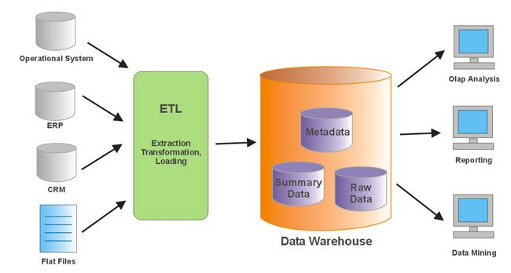
Data Consolidation

Slide 30
Data Scheduling
Data Integration – In business process, you may require to get some data from other departments like sales, marketing, finance, accounting, etc. You can schedule your data transfer jobs to run at any frequency. It can be hourly, daily, weekly, monthly, or yearly. You can set execution times for data load rules by scheduling them. For example, you may want actual sales ordering data to be imported into corporate systems everyday at 12.00 am.
Schedule for data collection and consolidation (7-11)
Schedule jobs for consolidation tasks (SAP)

